Slide 1




CSP 571: Data Preparation and Analysis
Project Final Presentation
Bike Sharing Demand
By:-
Chirag Bhansali
Pritam Gajbhiye

Slide 2
Bike Sharing Demand
Description
Capital Bikeshare Program, Washington DC
Renting bicycles
Return to kiosk locations located throughout the cities
Research Question
To Predict/forecast bike rental demand
Features important for prediction
How demand is affected by various factors such as time, weather, holidays and seasons

Slide 3
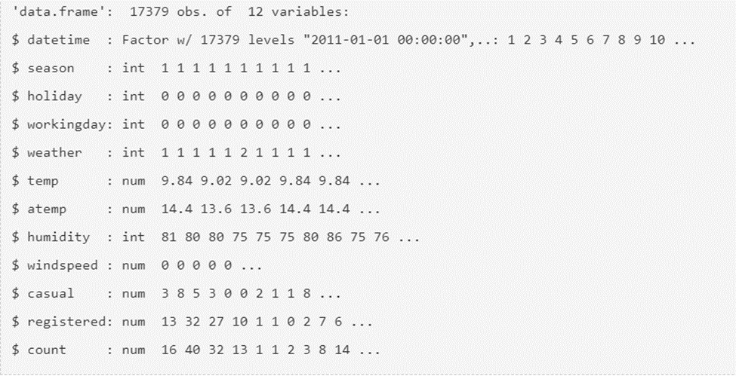
Data Preparation and Cleaning
Dataset is from Kaggle competition and available at UCI ML Repository
http://archive.ics.uci.edu/ml/datasets/Bike+Sharing+Dataset
Data type identification
Feature Engineering

Slide 4
Data Preparation and Cleaning : Feature Engineering
Changing variable type to categorical for season, holiday, working day and weather
Extracting separate information (i.e., date, hour, weekday) from datetime variable

Slide 5
Prior Hypothesis Generation
Hourly Trend : High demand during office timings.
Daily Trend : registered users demand more bikes on weekdays.
Rain : The demand of bikes must be low in rainy weather.
Temperature : The demand must be high in warm weather.
Time : Demand must be increase with time.

Slide 6
Exploratory Data Analysis
Missing Value Analysis
Understanding distribution of numerical variables.
Outlier Analysis
Prior assumed hypothesis testing

Slide 7

Exploratory Data Analysis : Missing Values

Slide 8
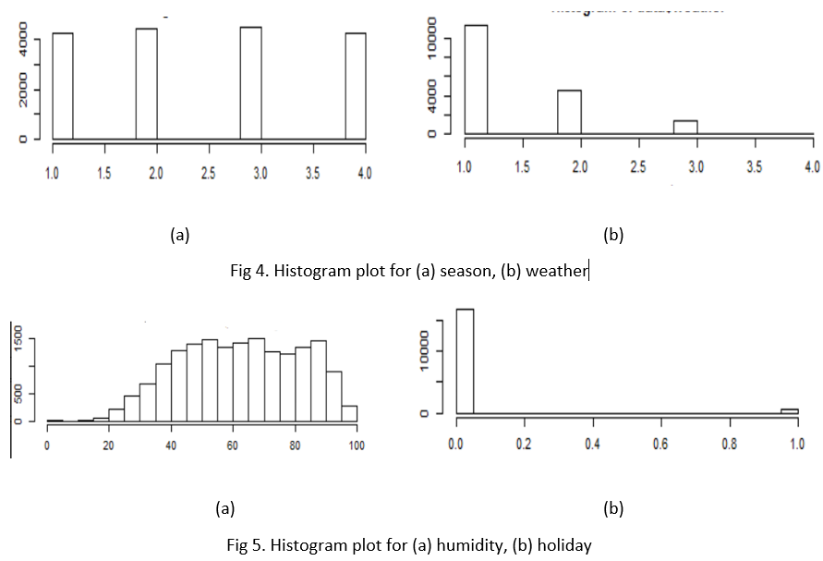
Exploratory Data Analysis : Understanding distribution of numerical variables

Slide 9
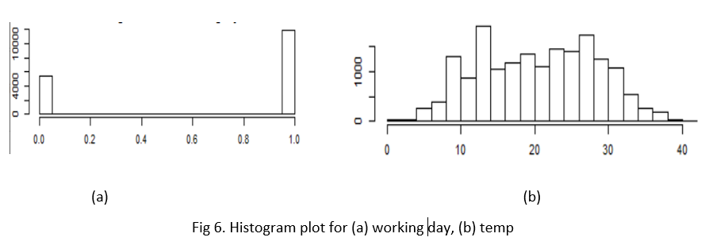
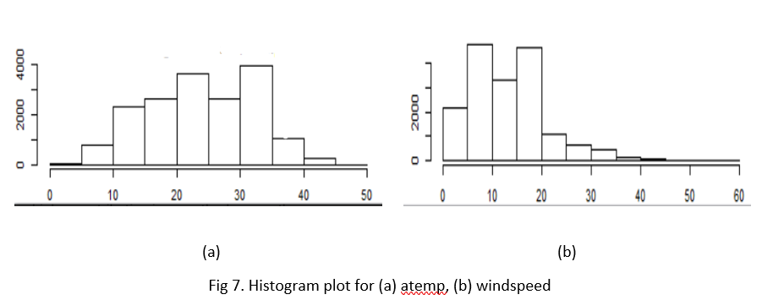
Understanding distribution of numerical variables continued

Slide 10
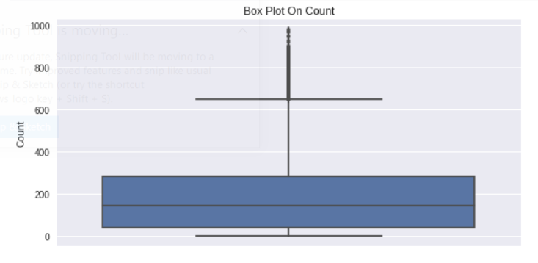
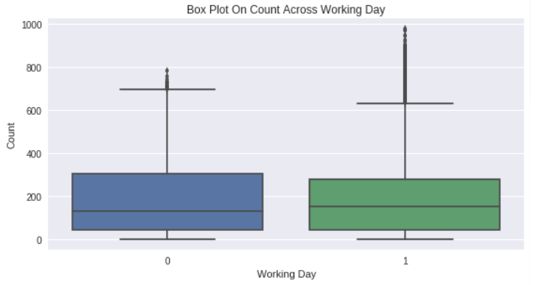
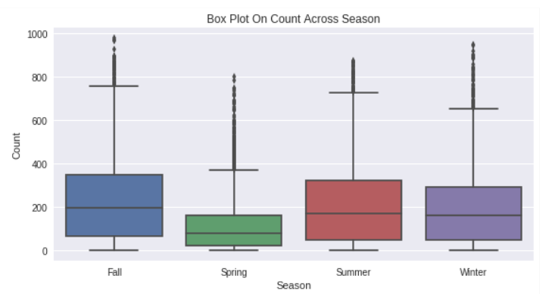
Exploratory data analysis : Outlier analysis

Slide 11
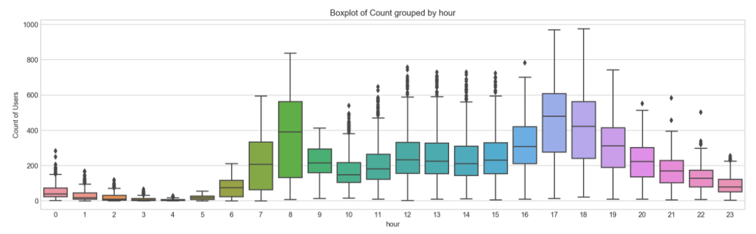
Exploratory data analysis : Prior assumed hypothesis testing Hourly Trend

Slide 12
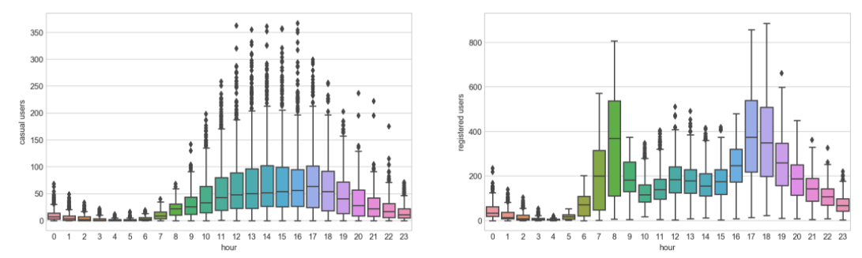
Exploratory data analysis : Prior assumed hypothesis testing Hourly Trend contd.

Slide 13
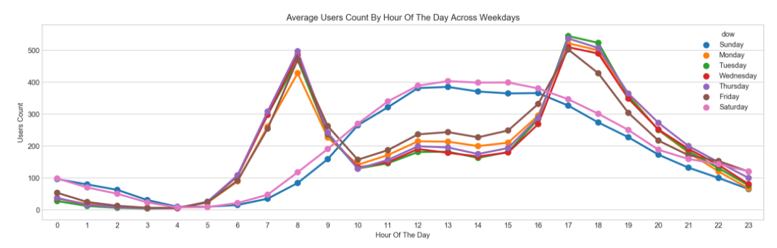
Exploratory data analysis : Prior assumed hypothesis testing Daily Trend

Slide 14
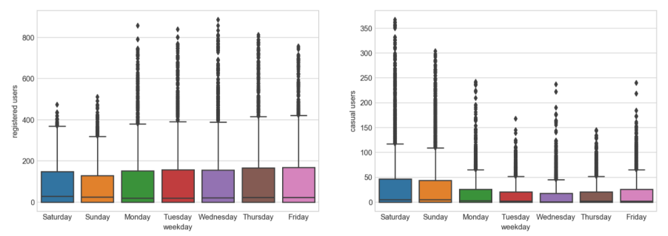
Exploratory data analysis : Prior assumed hypothesis testing Daily Trend contd.

Slide 15
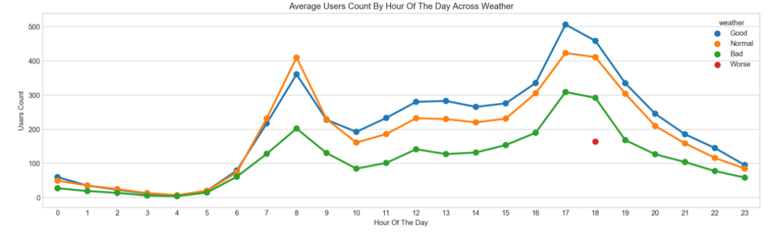
Exploratory data analysis : Prior assumed hypothesis testing Rain

Slide 16
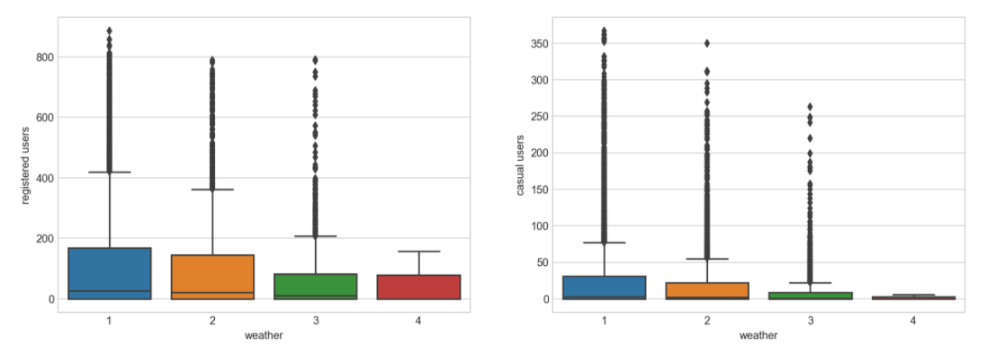
Exploratory data analysis : Prior assumed hypothesis testing Rain Contd.

Slide 17
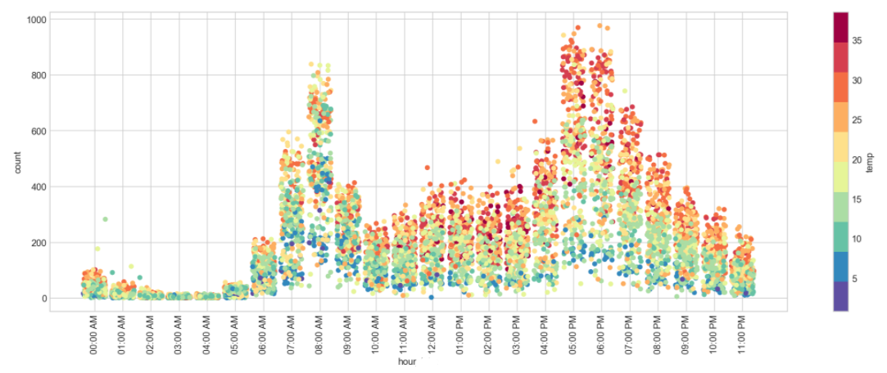
Exploratory data analysis : Prior assumed hypothesis testing Temperature

Slide 18
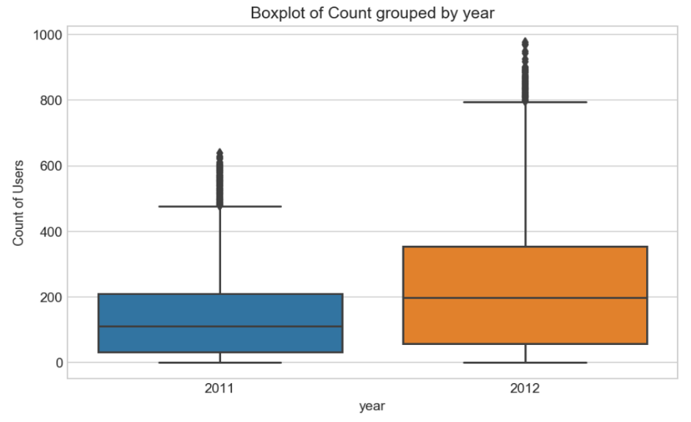
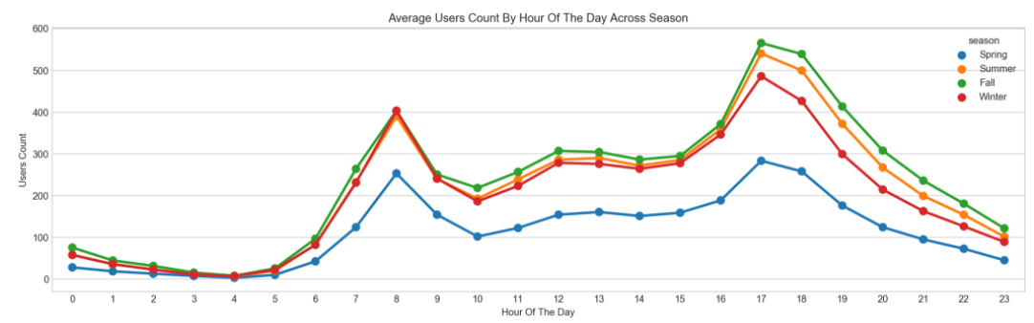
Exploratory data analysis : Prior assumed hypothesis testing Time and Season

Slide 19
Modeling (Model Training and validation)
Evaluation criteria
Linear Regression Model
Random Forest Model
Gradient Boosting Regression Tree

Slide 20
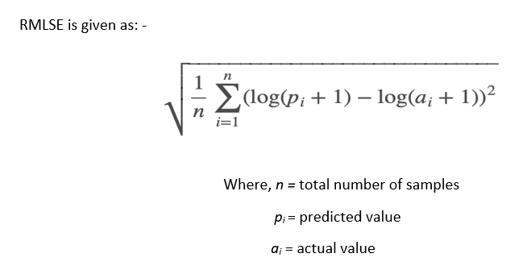
Evaluation Criteria

Slide 21
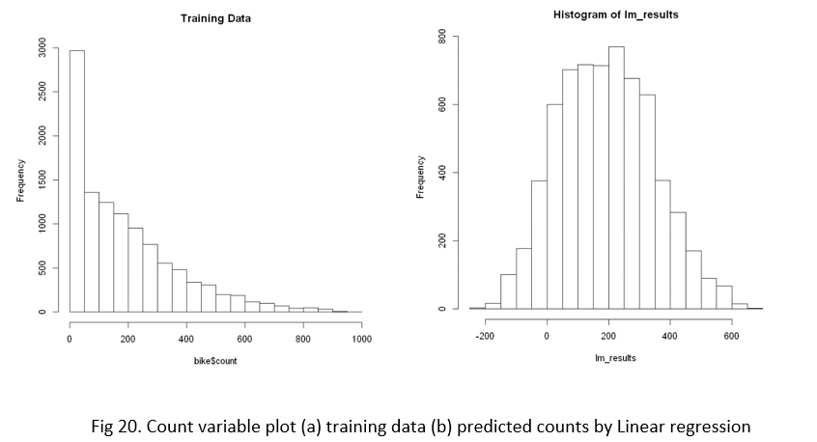
Linear Regression Model Training RMSLE: 1.027 Testing RMSLE: 1.004

Slide 22
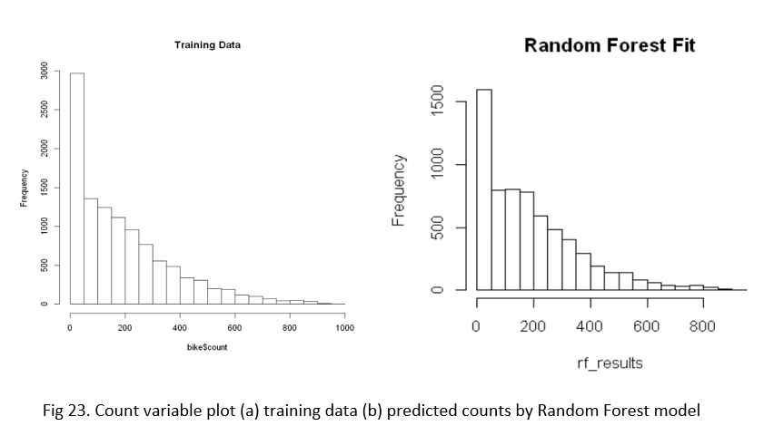
Random Forest Model Training RMSLE: 0.256 Testing RMSLE: 0.241

Slide 23
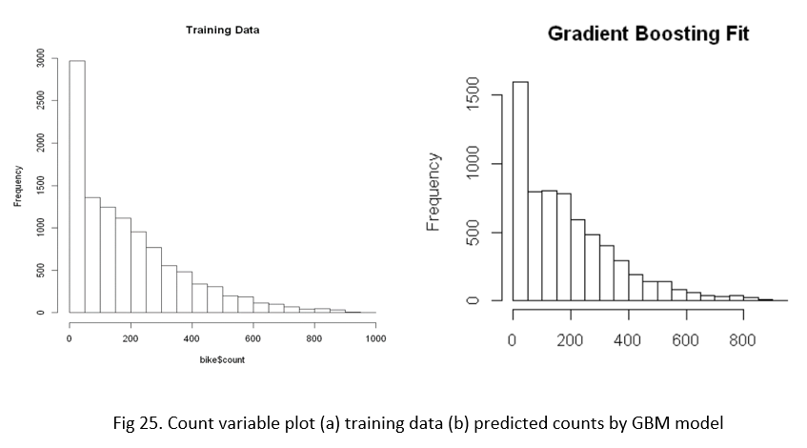
Gradient Boosting Regression Tree Training RMSLE: 0.241 Testing RMSLE: 0.29

Slide 24
Conclusion
Overall, the performance of Gradient Boosting Regression Tree and Random Forest is better than Linear Regression.
Important hidden insights were derived in Exploratory data analysis stage.
Further improvements are possible by adding some information from census and biodiversity data.
Further we can answer some questions such as: Does the biodiversity (greenery/parks) affect the rental demand in that area? Which race mostly use such programs? What is the annual income of the users? Etc.

Slide 25





Thank You !!

